Slide 1
KRISHNANUGRAHA
Fit Institute
&
Special Adoption Agency

Slide 2
Address:
Vasundara Nagar,
Malpe – Ashirwad Road
Laxminagara,Santhekatte,
Udupi- 576 105
Karnataka, India
www.srikrishnacharitable.org/

Slide 3
Who we are…..?
“Krishnanugraha”, licensed as Fit Institute and Special Adoption Agency from the department of women and child development, Government of Karnataka, started in September 2004 with 19 destitute/abandoned children in need of Care & Protection. The Chairman is late Shri T V Rao and the Managing Trustee is Dr. Umesh Prabhu.
Till date around 250 children have been admitted to the institute.“Krishnanugraha” get children who are surrendered by parents who are unable to nurture the child and unwed mothers who surrender because of the social stigma or due to the health issues of the child. Some children are found on streets begging or run away from homes. Some are been tortured or neglected by parents, and some are victims of abuse or child labourers and missing children. These children are been brought to the institute by the Child Welfare Committee, public, police and the parents themselves.

Slide 4
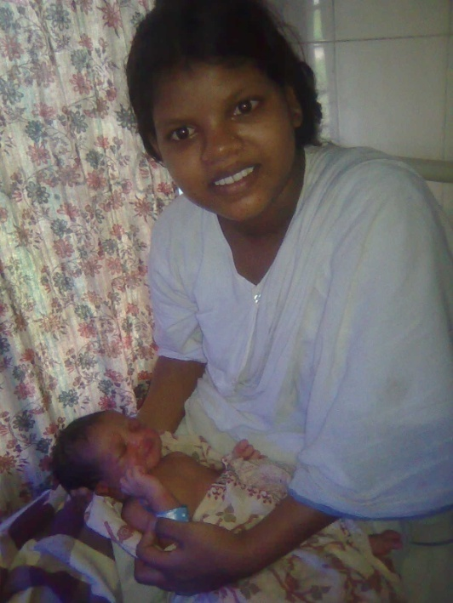
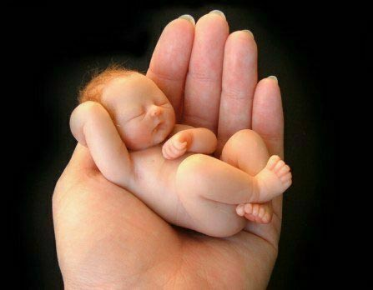
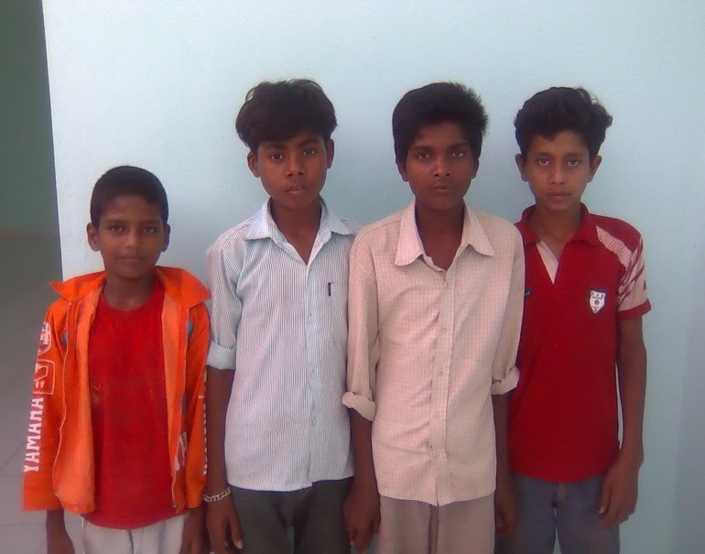
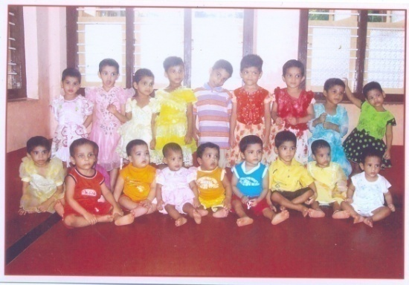
What we do……?
Lots of healthy children are been placed beautifully into the loving hands of adoptive parents. Many children absconded from home or work place or child laborers were restored back to their parents. There are children who are suffering from cardiac problems, cerebral palsy, mental retardation, multiple deformities , blindness etc. They are given required care and protection with medical facilities. Many minor unwed mothers who had come during their pregnancy were given antenatal and postnatal care.

Slide 5
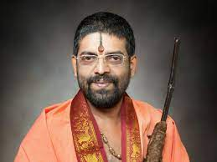
Honorary Presidents
Gives us blessings to Pursue the Glorious work
Sri Sri Sri Lakshmivara Teertha Swamiji
Shiroor Matt, Udupi
2010-2018
Sri Sri Sri Vidhyadeesha theertha Svamiji
Sri palimaru matt, Udupi
2021 onwards

Slide 6
Founder of the trust

Slide 7
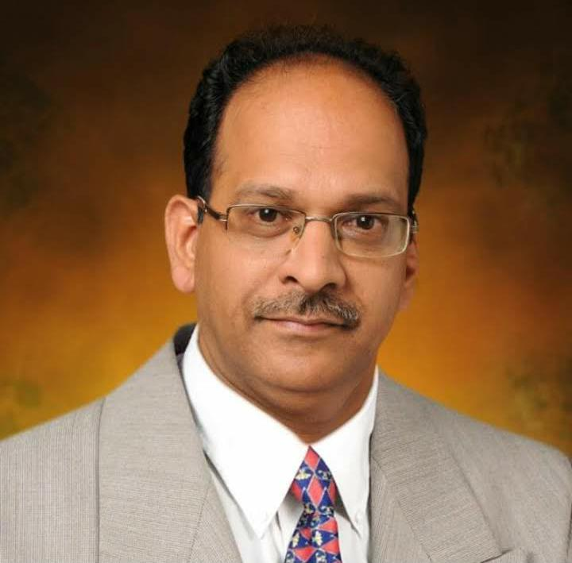
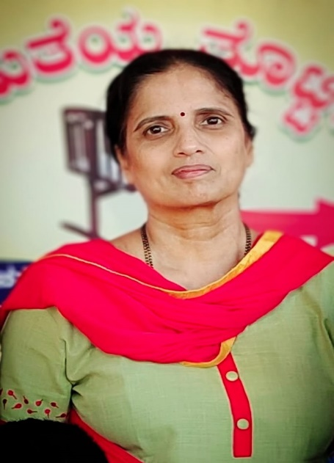
GOVERNING COUNCIL
Our Power strength for today and vision for tomorrow
Prepares the mind to receive the best that life has to offer
DR. UMESH PRABHU
MANAGING TRUSTEE
DR. JAHNAVI RAO
TRUSTEE

Slide 8
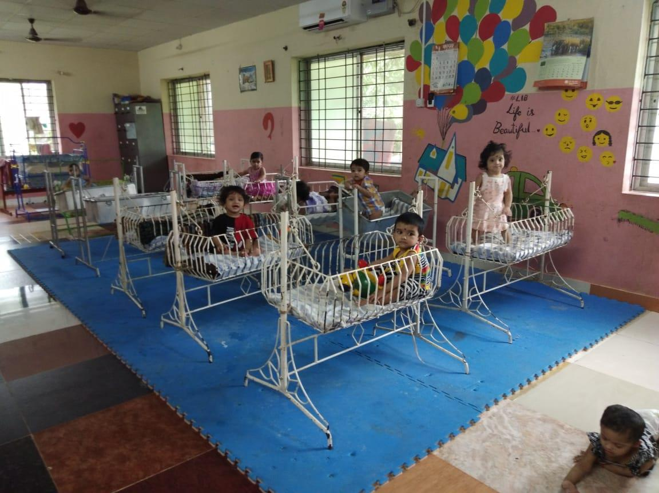
PRESENT LOVING KIDS…..

Slide 9
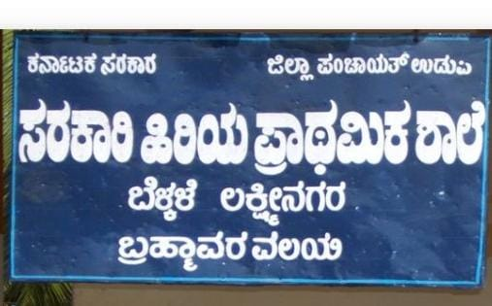
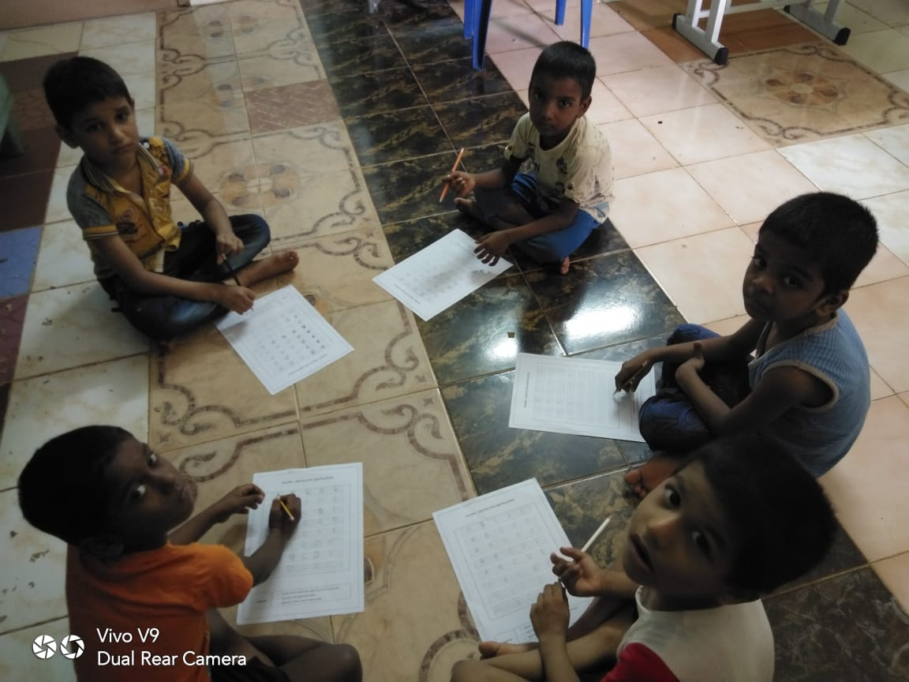
KRISHNANUGRAHA SCHOOL KIDS……

Slide 10
CHILDRENS’ DAY CELEBRATION…..

Slide 11
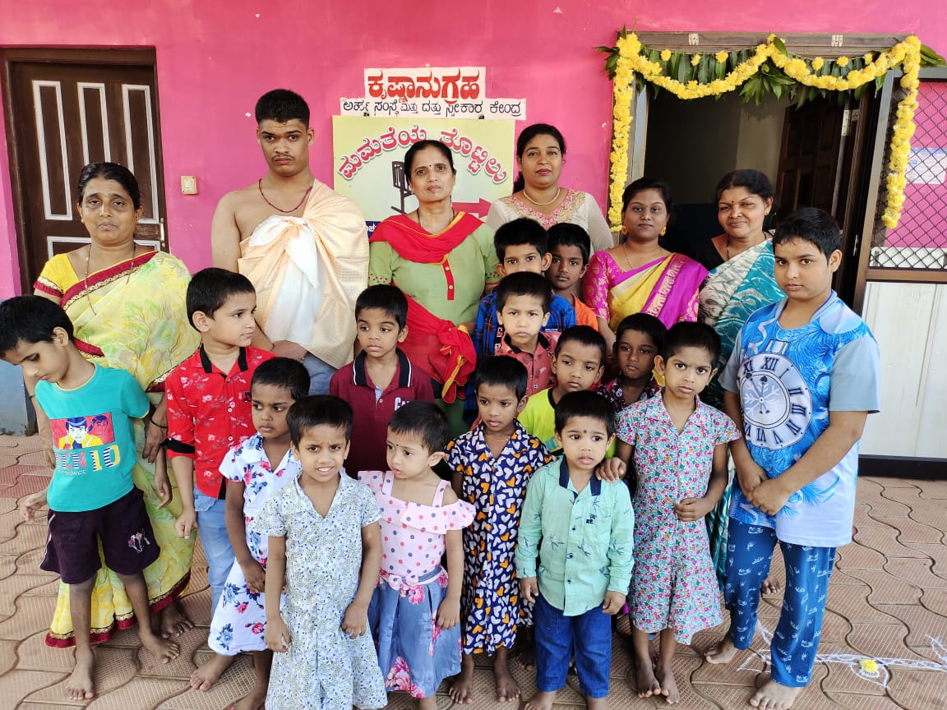
DEEPAVALI CELEBRATION…..

Slide 12
EID CELEBRATION…..

Slide 13
CHRISTMAS CELEBRATION…..

Slide 14
Ganesh Chaturthi Celebration

Slide 15
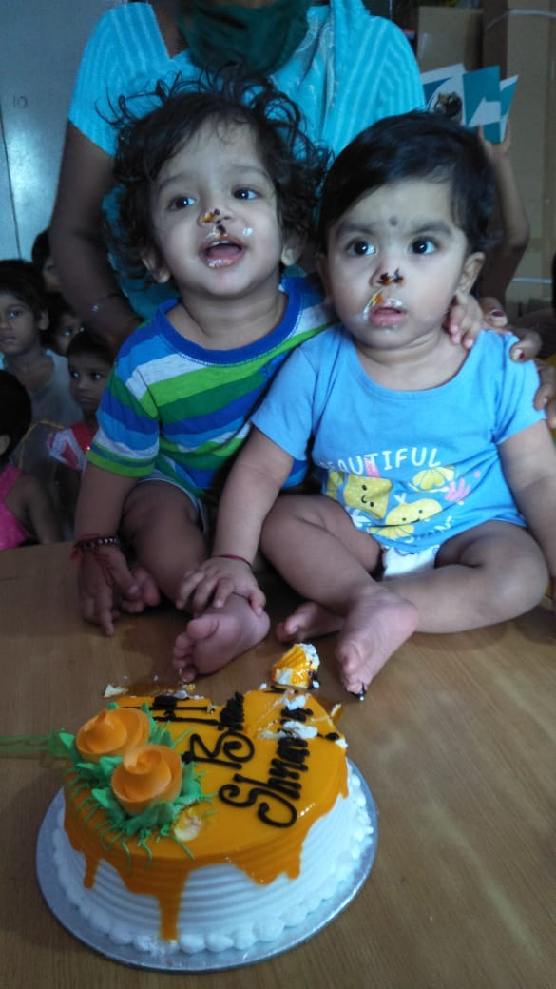
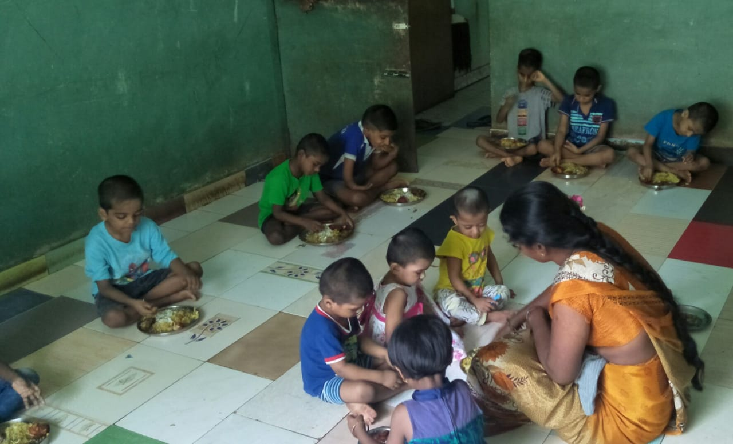
BIRTHDAY CELEBRATIONS…..

Slide 16
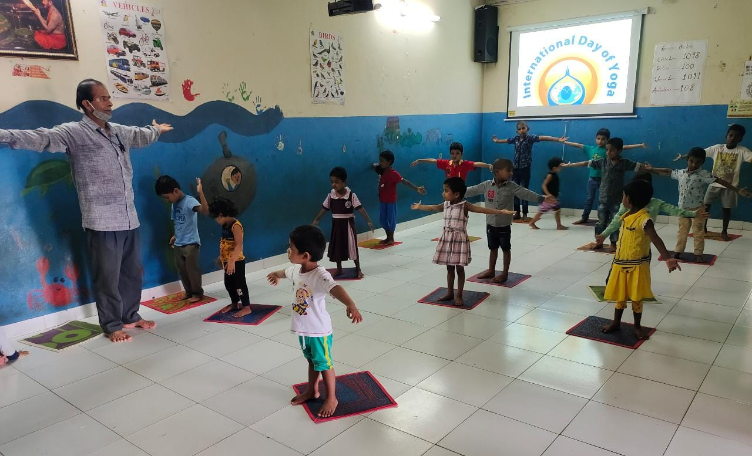
INTERNATIONAL YOGA DAY…

Slide 17
CHILDREN WITH SPECIAL NEEDS….
CHANDBABI: 15YRS
SPASTIC CEREBRAL PALSY WITH MENTAL RETARDATION
REHABILITATION:
Special education

Slide 18
KAUSHIK: 7 YRS
CHILD WITH OSTEOGENESIS IMPERFECTA
BRITTLE BONE DISEASE
REHABILITATION:
MEDICAL AND PHYSICAL

Slide 19
LAVANYA: 6 YEARS
PARTIAL BLINDNESS WITH MENTAL RETARDATION
REHABILITATION:
EYE SURGERY REQUIRED

Slide 20
DEEKSHA: 9 YEARS
GLOBAL DELAY, FLOPPY CHILD
REHABILITATION:
PHYSIOTHERAPY

Slide 21
GAHANA: 3 YEARS
CONGINITAL ADRENAL HYPERPLAXIA
REHABILITATION:
MEDICAL AND GENITAL RECONSTRUTION INTERVENTION

Slide 22
YASHAS: 11 YRS
RADIAL CLUB HAND(RIGHT)
ABSENT THUMB(LEFT)
REHABILITATION:
CORRECTIVE SURGERY

Slide 23
KIRAN : 9 YRS
ABSENSE OF GENITALS AND URETHRA SYNDROME
REHABILITATION:
MEDICAL AND RECONSTRUTIVE SURGERY

Slide 24
SINCHANA: 3 YEARS
DOWN SYNDROME WITH DELAY
REHABILITATION:
PHYSICAL AND EDUCATIONAL INTERVENTION

Slide 25
KRITHIKA: 2YEARS
SEPTIC SHOCK WITH GLOBAL DELAY AND SPASTIC
REHABILITATION:
PHYSIOTHERAPY INTERVENTION

Slide 26
DURGA: 7 YEARS
BLIND CHILD
REHABILITATION:
SURGERY AND SPECIAL EDUCATION

Slide 27
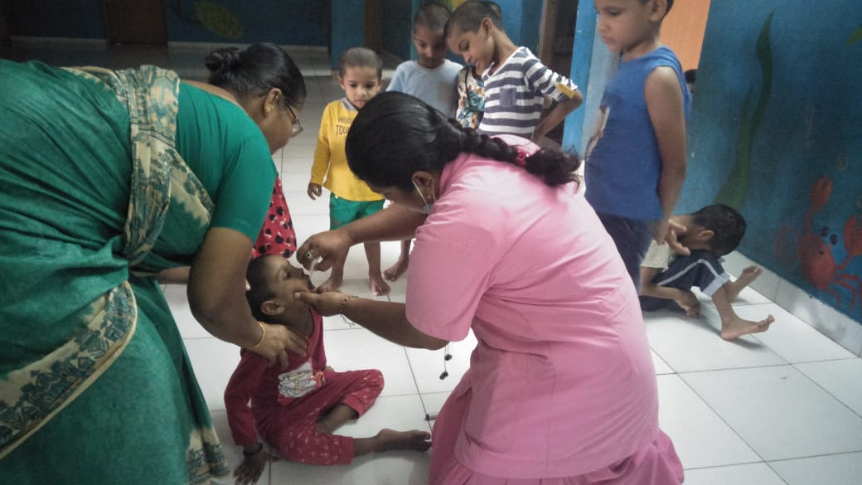
Regular medical checkups..

Slide 28
Inauguration of the Institute by our Beloved Founder Late Sri T V RAO

Slide 29
VISIT BY Mr. Jayaprakash Hegde

Slide 30
Visit by Sri Vidhyadeesha Theertha Sripadaru

Slide 31
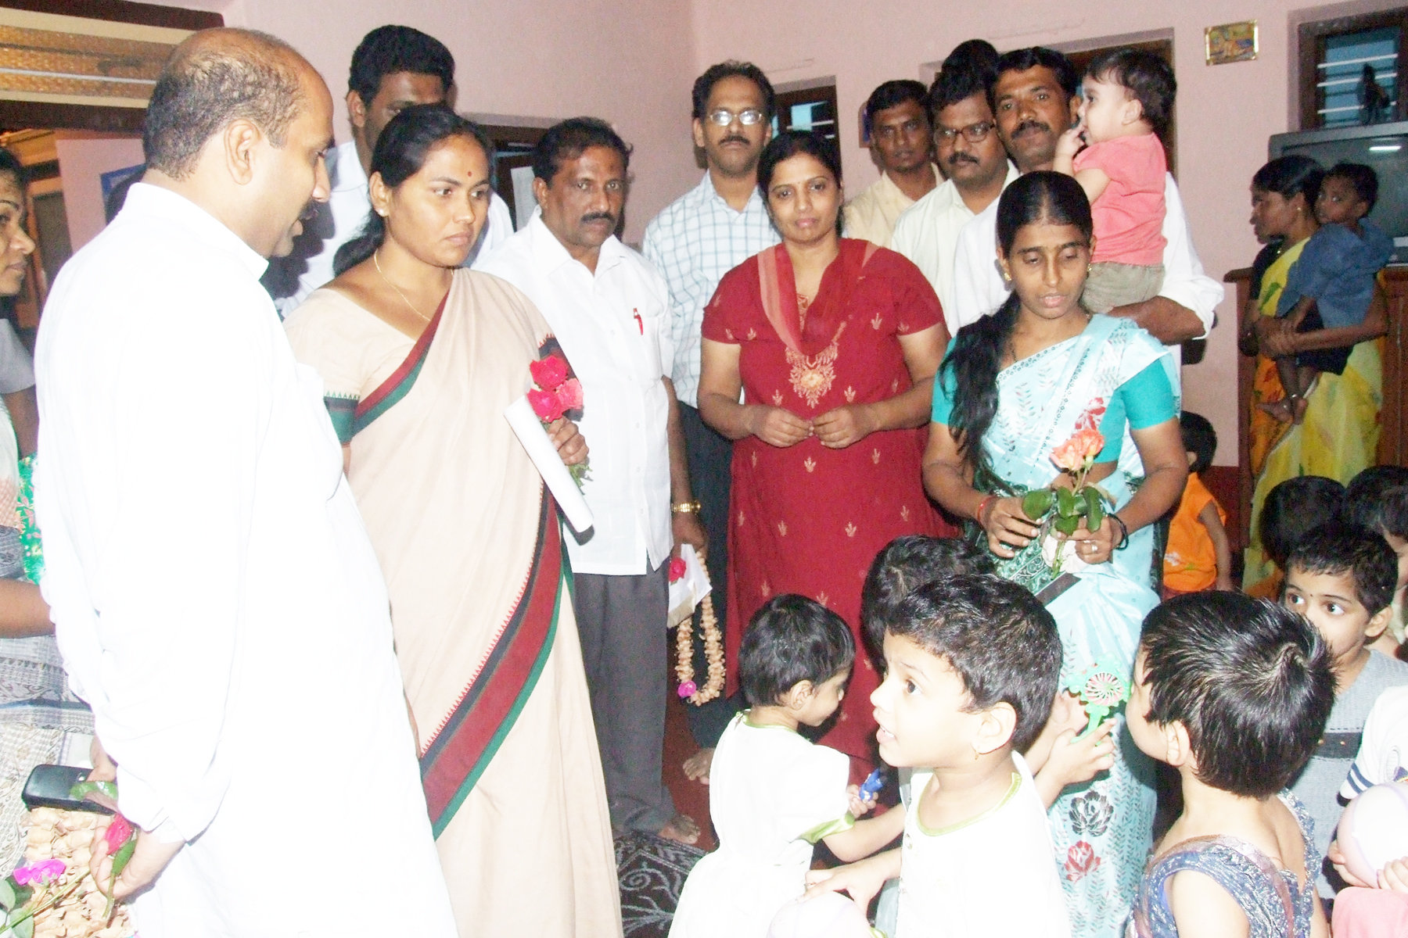
Visit by Shoba Karandlaje & Raghupathi Bhat

Slide 32
Visit by Arjun Kapiakad…

Slide 33
VISIT BY Saraswathi Swamiji..

Slide 34
Visit by Women Police Station, Udupi

Slide 35
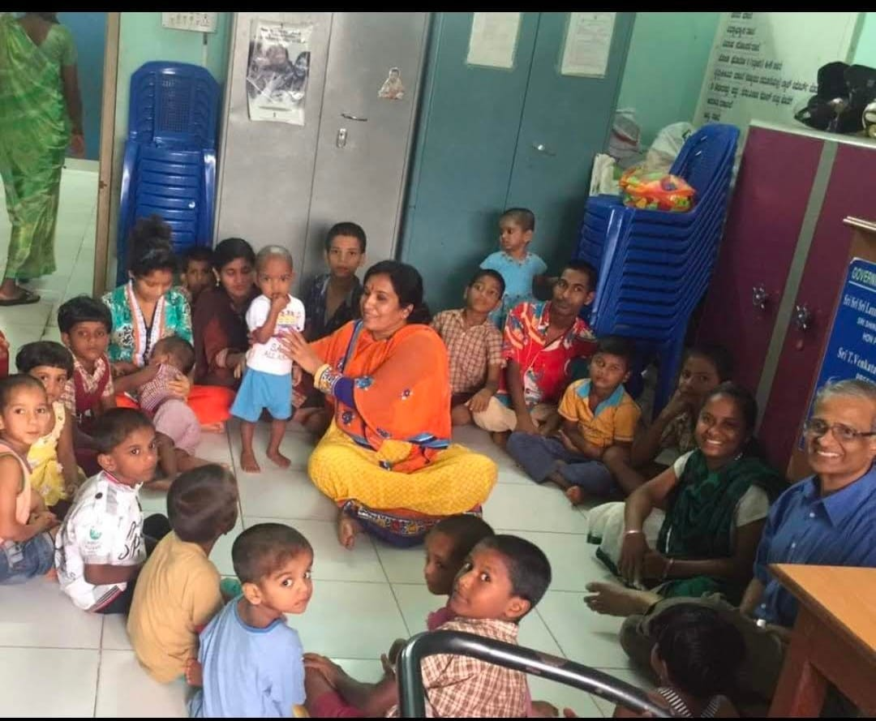
Visit by Vanitha Thorvi

Slide 36
Visit by Sri-Sri-Sri-Vishwapriya-Tirtha-Swamiji

Slide 37
Visit by Hosabelaku- Israel

Slide 38
VISIT BY Youth Congress…

Slide 39
FURTHER PLANS…..
Panchavati Senior Citizen Home
Srikrishna Charitable Super Speciality Hospital
Mahatma Gandhi Residential School for Blind and visually Impaired
New buildings for ‘Krishnanugraha” Adoption center

Slide 40
PRESENT NEED FOR CHILDREN
4 computers for children for smart class/ Online class/ computer training
Surgical corrections for 5 special need children
A. Mast. _______ 10years suffering from radial club hand right with syndactyly He had already undergone surgery for the left. Now he needs correction of deformity and Pollicization of right hand
B. ________ – who had absense of genitals and urethra syndrome
C. _____ – a blind child for brail training
D. _________: for genital reconstruction intervention
E. _______ : down syndrome with delay
3. Monthly medical expenses for special need children Rs. 15000/month
4. Four wheeler to shift the children in emergency to the hospital , to take the children for outing on weekends , take them to the court in the legal dispute of the parents and to the school.

Slide 41
HAPPY MOMMENTS…

Slide 42
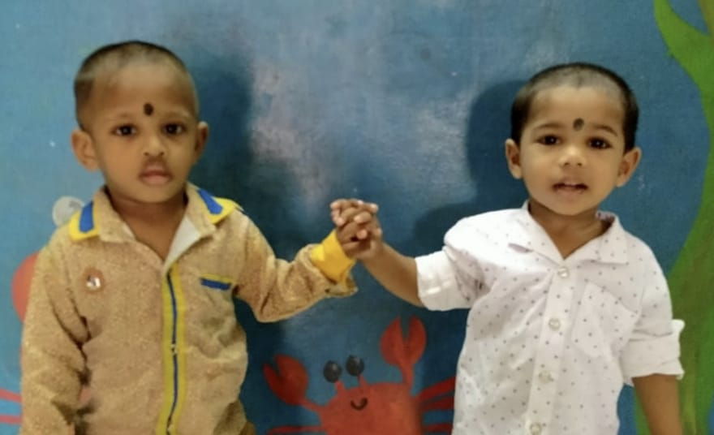
THANK YOU…

