Slide 1
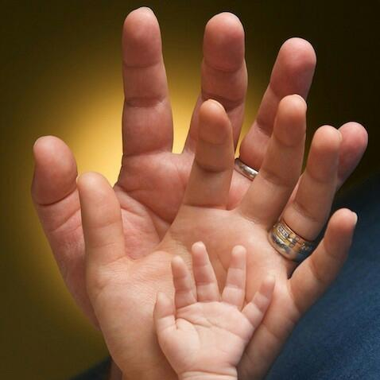
Adoption
Presentation By:
Merina Elizabeth

Slide 2
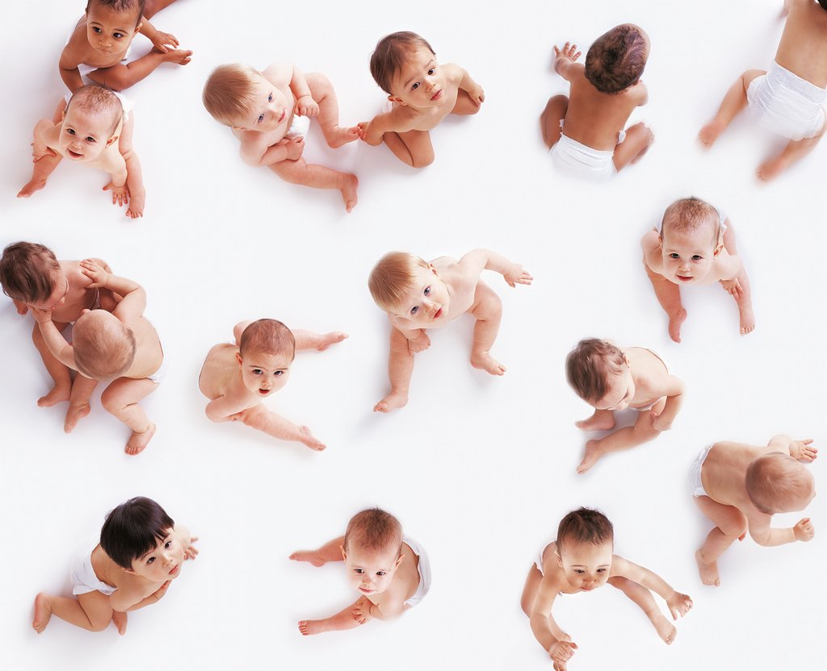
“Family for a Child” not
“Child for a Family”

Slide 3

Biology is a fact of Life
Parenting is an act of Love

Slide 4
What is Adoption?
Essentially a Social Process
Family – Parenthood by “Procreation” or Parenthood by “Adoption”
Parenthood : A function. of Heart & not of Biology
Needs: Adoption meets reciprocal needs
CHILD’s need : For a permanent nurturing home
ADOPTIVE PARENTS' need : Bring up as their “Own Child” & building a family in a beautiful way
Experience – Entirely emotional

Slide 5
According to Law
Under Juvenile Justice Act(Care and Protection of Children)
“Adoption is the creation of a parent-child relationship by judicial order between two parties who usually are unrelated. This relationship is brought about only after a determination that the child is an orphan or has been abandoned or that the parental rights have been terminated by the court’s order.

Slide 6
Stages of Adoption
Registration
Pre-adoption Counselling And Preparation
Home Study And Other Requirements
Referral And Acceptance
Pre-adoption Foster Care
Legal Procedure
Follow Up & Post-Adoption

Slide 7
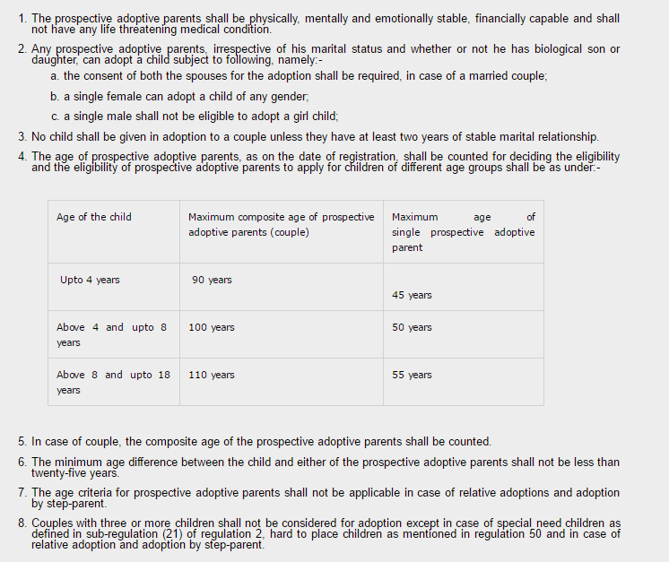
ELIGIBILITY

Slide 8
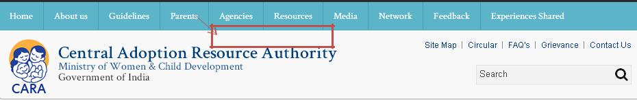
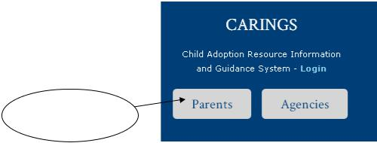
STEP-1
· Open www.cara.nic.in and click on Parents
click on Parents
click on Parents

Slide 9
Click here

Slide 10

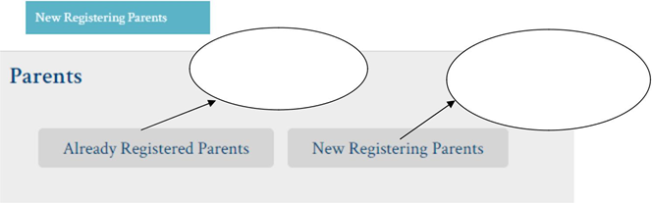

Slide 11
STEP-4

Slide 12
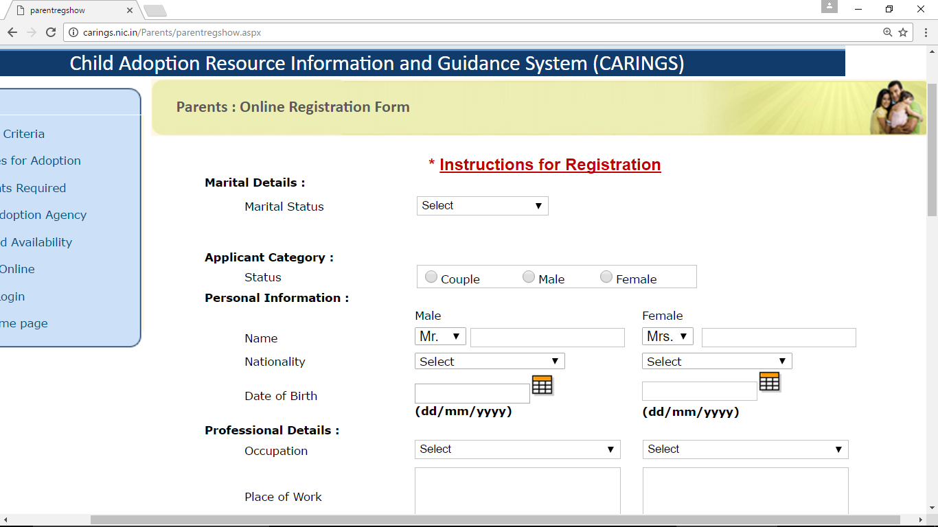

Slide 13
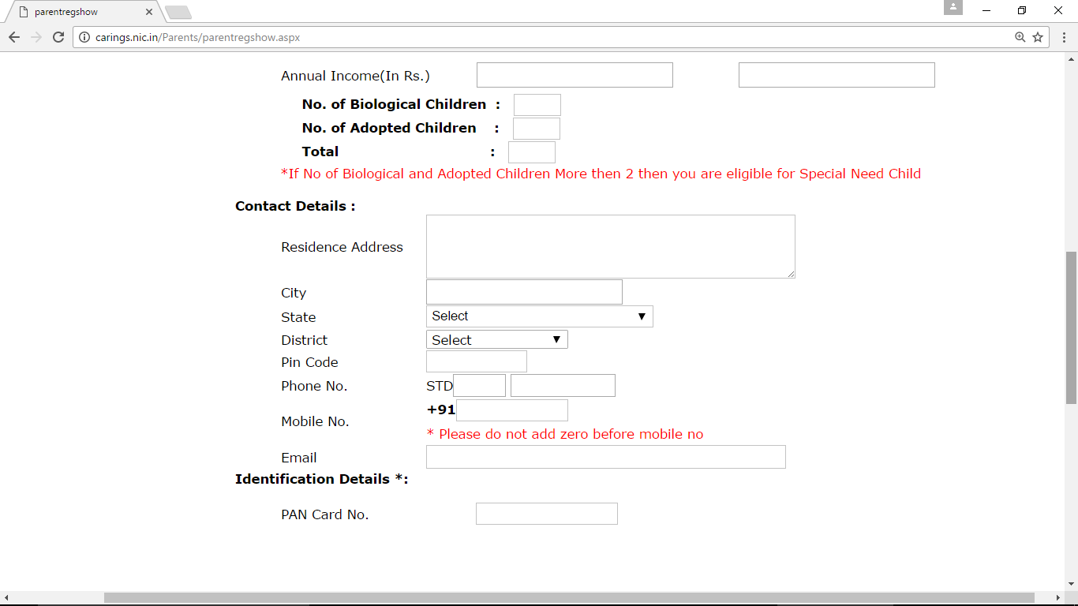

Slide 14
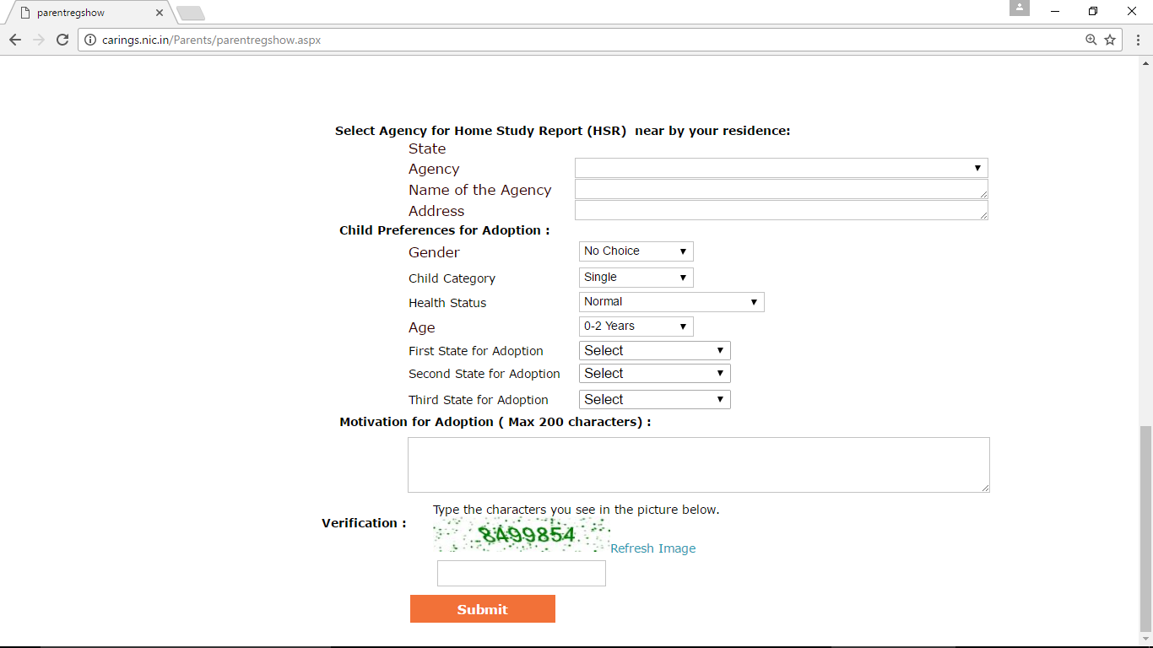

Slide 15
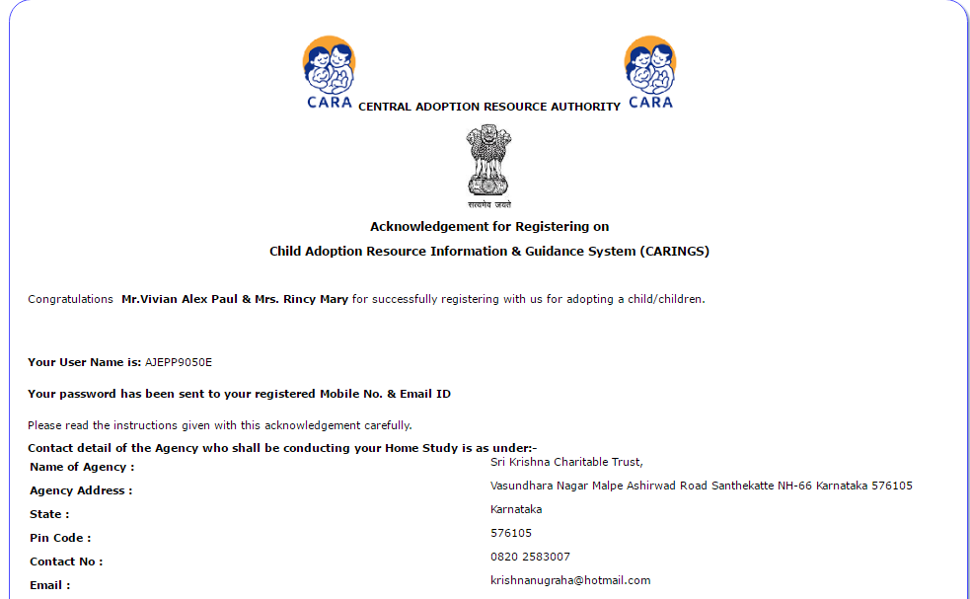

Slide 16
VERY IMPORTANT
You are requested to upload the following documents by 30 Days, otherwise your registration shall be cancelled

Slide 17
Documents required for
in-country adoption
Proof of Identity: PAN Card & AADHAR Card
Proof of address: AADHAR Card
Proof of Birth: SSLC Certificate
Educational Certificates
Marriage Certificate
Recent Couple Photo(Size 4x6 inch): 3 Photos
Health Certificate (as per given Format): by a registered medical Practitioner (with original lab reports). Certifying that the parents are not suffering from any contagious or terminal illness, may be mental or physical, which may prevent them from taking care of the child.

Slide 18
Three Recommendation Letters: from persons (not immediate relatives) who know the family well enough to recommend them as good parents to adopt a child. (with sign, address & contact numbers)
IT Statement of 3 years if parent self-employed along with Declaration of Profession (Affidavit) OR Income Certificate/Salary Statement if employed, from the employer stating the date of superannuation. (Income should not be less than Rs.1,20,000/- per Anum)
Financial Statement: Copies of Bank statement for the last 6 months, Copies of Document pertaining to movable and immovable property owned by the family & Details of loan taken by the family.
Saving Details: Insurance Copies/ fixed Deposits/ shares/etc etc
Letter from close relative (20rs stamp paper): stating in event of any unforeseen circumstances, the relative would take care of the child (with sign, address and Contact number)

Slide 19
Copy of Passport: in case parents do not have, undertaking to that effect. (Affidavit)
Autobiographical Sketch: (as per the given questions) to be answered in detail separately by husband and wife on separate sheets.
Self-Assessment PART I: to be filled by the parents clearly.
Additional Documents:(if applicable)
Written Consent: if the family has a biological/adopted child above 6 yrs.
Birth Certificate/Adoption Decree: if the family has a biological/adopted child
Divorce decree/ Death Certificate/Affidavit: in case of Divorcee /Widow/Single.
Death certificate: if the family had a biological deceased child.

Slide 20
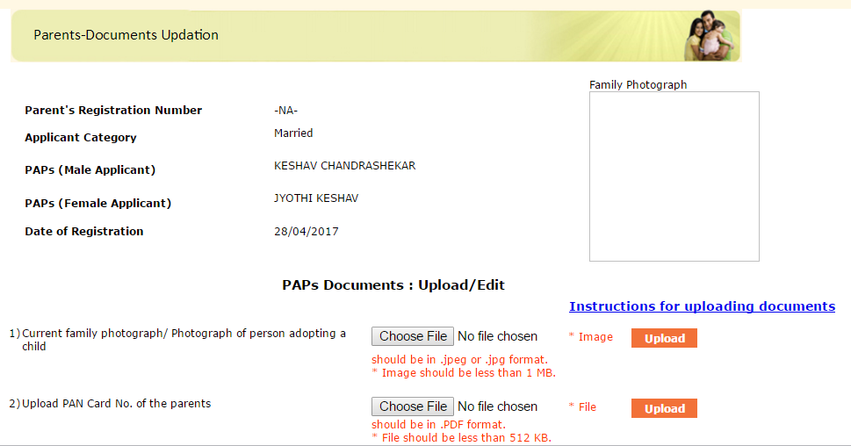

Slide 21
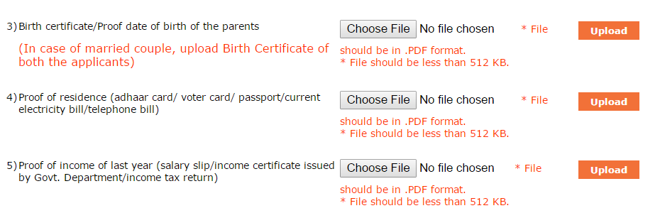
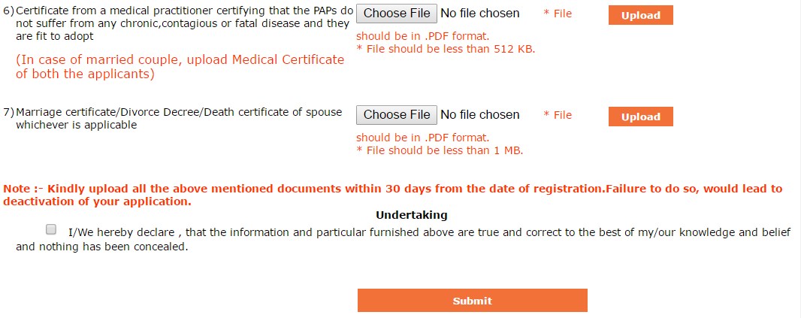

Slide 22
HOME STUDY
(HSR)
Your Home Study shall be conducted within 30 days of submission of the complete documents by the PAP personally at the adoption agency.
You are required to pay an amount of Rs. 6000/- to the SAA for preparation of Home Study Report (HSR) and uploading the same on CARINGS.
Based on the HSR confirming your eligibility by the SAA you shall be placed in waiting list.
Validity of HSR shall be three years.

Slide 23
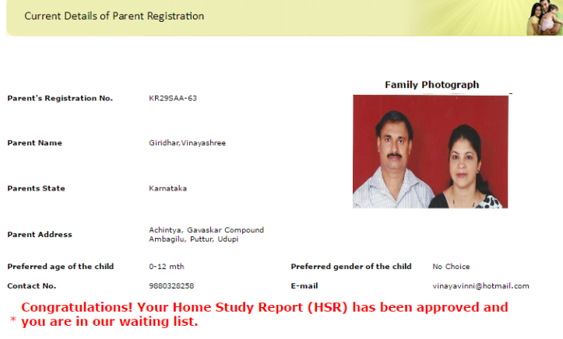
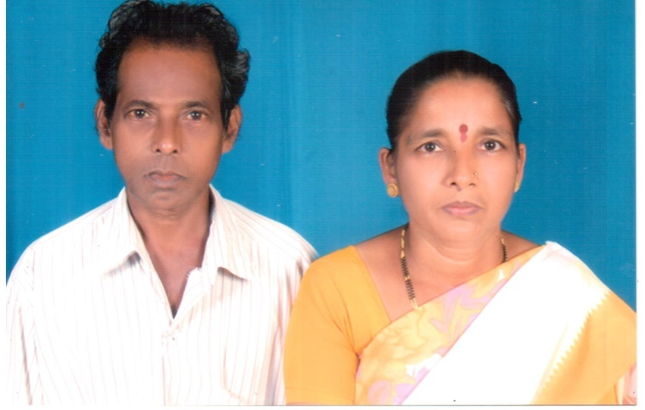

Slide 24
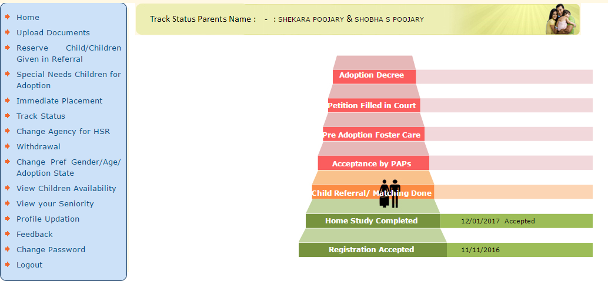
Track Status

Slide 25
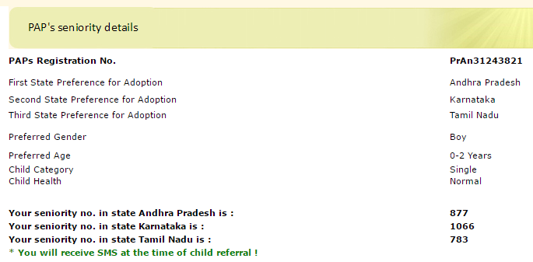
View Seniority

Slide 26
Referral & Matching
Information will be sent through SMS and Email
Congratulations! You have been referred with the profile of the child. Please login on CARINGS with your user-id and password and reserve within 48hrs.
The referred children’s photograph, Child Study Report (CSR) & Medical Examination Report (MER) would be available online.
Only one profile of the child will be shown according to the age and sex of your preferred child .

Slide 27
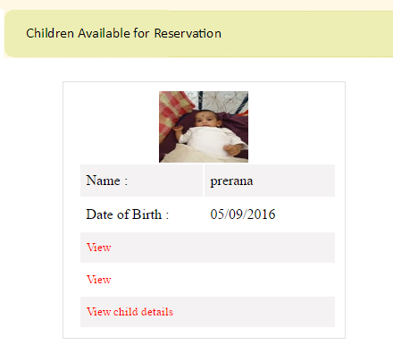
Referred Child

Slide 28
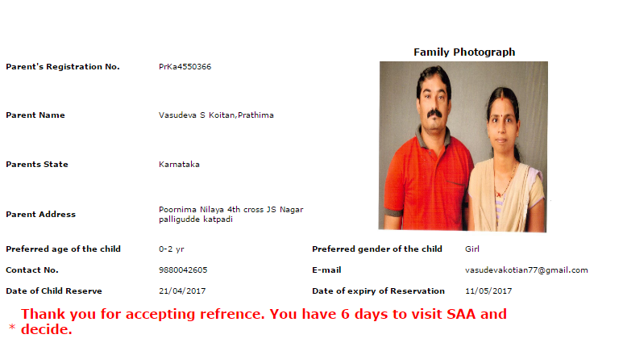

Slide 29
TIMELINE
After reserving a child you must immediately contact the Specialized Adoption Agency (SAA) from where you’ve reserved the child. The matching shall be done by the Adoption Committee after which you shall be giving consent for accepting the child and this process has to be completed within 20 days from the date of reserving the child. Non-acceptance after matching, within the stipulated time frame, shall release the child & push you to the bottom of the seniority list.

Slide 30
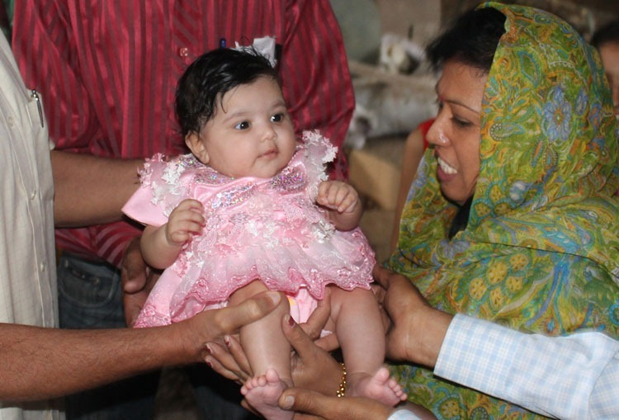
Pre-adoption Foster Care
Visit to the SAA
Document Verification
Adoption Referral Committee meeting
Meet the Child personally
The maintenance charges
of the child will be paid by the
parents.

Slide 31

Legal Procedure
The petition is filed in the District Court where the SAA is located
The Court will dispose the case within 2 months.
The Certified Copy of the Court order will be sent to the parents.
Registration of adoption deed shall not be neccessary.
The SAA shall obtain the Birth Certificate with the adopted parents name.

Slide 32

Follow Up & Post-Adoption
The SAA will report every six months the progress of the child for 2years and upload the report online.
In case of adjustment problems the SAA can arrange for necessary counselling.

Slide 33
Some Important Points
3 single referrals of child in a period of 90days each, then the seniority will be pushed down.
Adoption leave: 3 months
Right age for Disclosure of adoption to the child
Keep checking CARINGS once in a week.
Keep in touch with the agency and other adoptive families.
Be committed in the whole process.

Slide 34

“I didn’t give you the gift of life,
But in my heart I know.
The love I feel is deep and real,
As if it had been so.
For us to have each other
Is like a dream come true!
No, I didn’t give you
The gift of life,
Life gave me the gift of you.”

Slide 35

Thank You

